Slide 1
Visual Recognitionusing Deep Learning
2025 Spring, Homework 1
Release Date: 2025/03/05 12:00
Notes:
‹#›

Slide 2
Homework 1
Deadline: 23:59, 03/26 (Wed), 2025
Participate the competition (80%): Image Classification Problem
Participant the competition on the CodaBench and get the highest score as possible. (70%)
Code reliability & quality (10%)
Report and code (20%): Document your method and findings.
Report
In PDF format and written in English. (5pt penalty)
Introduction to your method (e.g., data pre-processing, model architecture, hyper-parameters)
Innovative ideas or additional experiments to further improve the model.
Code
Zip your code (.py) alone with report - Submit to E3.
You should also put your code on your GitHub repository and provide the link in the report.

Slide 3
Links
Link to the dataset
Link to the competition

Slide 4
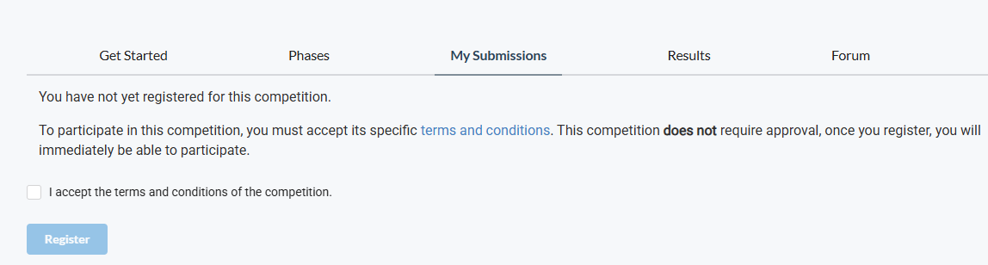
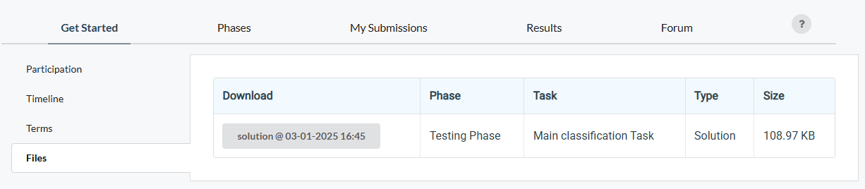
How to participate the competition and do submission
Register an account on CodaBench
When registering the account, please use your studentID as the UserName
After you click the competition link, go to My Submissions, and join the competition
An “example” submission

Slide 5
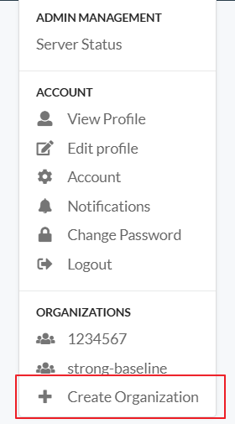
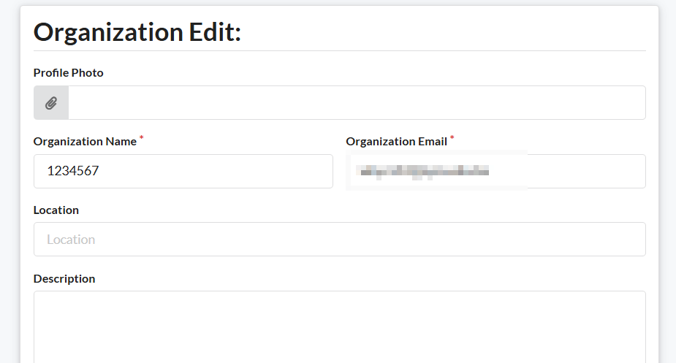
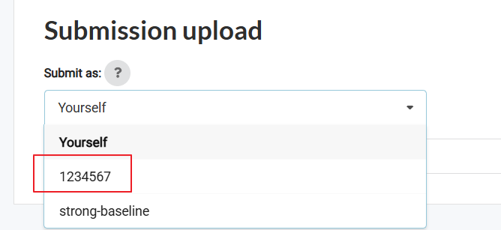
Account cannot be pure digit
MODIFIED on 3/13
1
2
Forget it
3
Notes:
ADDED on 2025/03/12

Slide 6
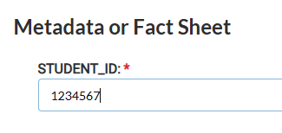
Account cannot be pure digit
MODIFIED on 3/13
1
Notes:
ADDED on 2025/03/12

Slide 7
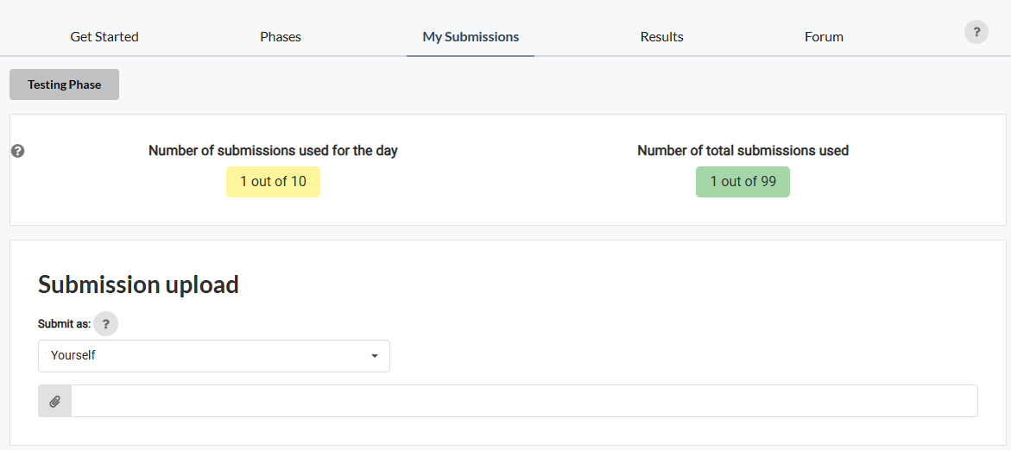


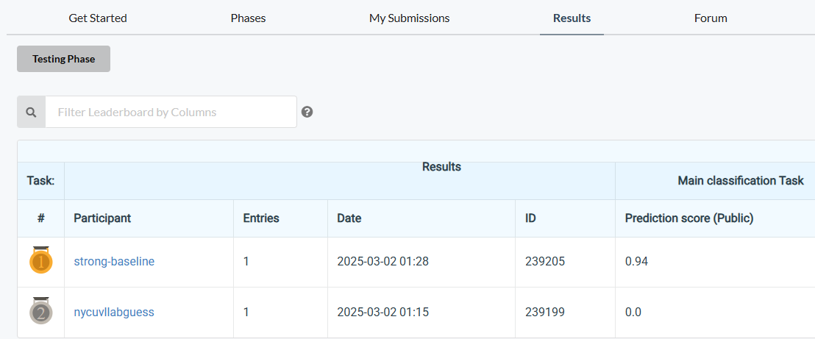
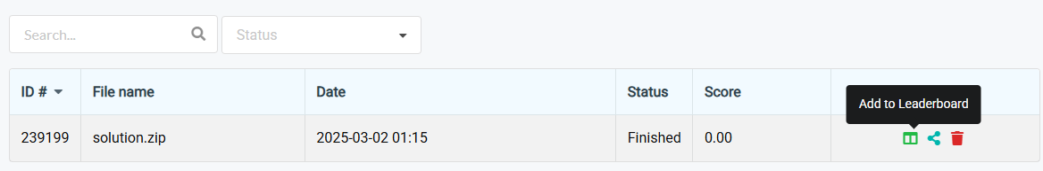
How to participate the competition and do submission
3. Submit your results and don’t forget to “Add to Leaderboard”
4. Don’t forget to check your results can be found on the leaderboard
No limitation for the name of the “zip” file; however, inside the zip file, your result file must be named “prediction.csv”

Slide 8
Coding Environment
Recommnedation: Python 3.9 or higher
Tips
We recommend you to use virtual environments when implementing your homework assignments.
Here are some popular virtual environment management tools
Poetry
Conda
Virtualenv

Slide 9
Numpy & PyTorch
Numpy Tutorial: Link
PyTorch Tutorial: Link
Free to use any modules and functions

Slide 10
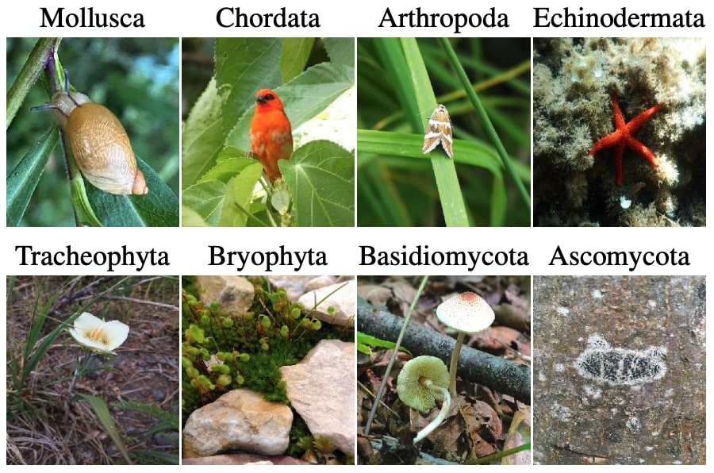
Task and Dataset
Task: Image classification
Inputs
RGB images
Training / Validation: 21,024; Test: 2,344
Target
Corresponding object category id of the image
100 categories
Additional Requirements / Limitations (15 pts penalty, each)
No external data (i.e., data from other sources) allowed.
Model size (#parameters) should less than 100M. (ways to check your #parms: Ref)
Also, you can only use ResNet (e.g., ResNet18/34/…) as the model backbone in this task. Modification to the backbone is allowed, elaborate your modification in the report may help you get good report score.
Not a requirement: pretrained weights is allowed.

Slide 11
Grading Policy - Report (20%)
Format: PDF, written in English. (-5pts if not followed)
Sections that you should include
Introduction to the task and core idea of your method
Method: Descbible how you pre-process the data; what is your model architecture, and hyperparameters, etc.
Results: your findings / model performance (e.g., training curve, confusion matrix, etc.)
References: Your method references (paper / Github sources, must include if you use any.)
We encourage you to stand on the shoulders of giants - only clone and run it is not enough.
Additional experiments to explore better performance
Simply tuning the hyper-parameters doesn’t count (e.g., batch-size, LR, different optimizers)
Hint: Try to add/remove some layers, use different loss functions, etc.
You should 1) include your hypothesis (why you do this), 2) How this may (or may not) work, and 3) The experiment results and their implications.
15pts
5pts

Slide 12
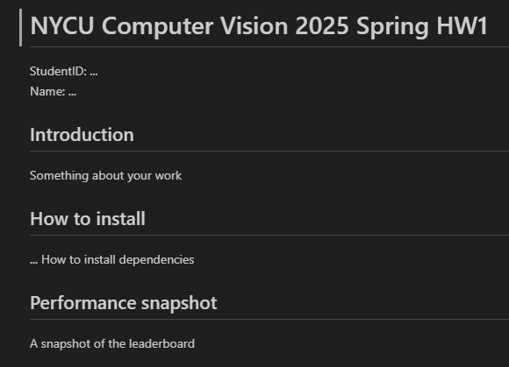
Grading Policy - Code Reliability (10%)
Python Coding Style Guide Reference
PEP8
Google Python Style
Please follow the PEP8 instructions and lint your code.
Push your code to the GitHub
It should contains a README.md to introduce this work (And your StudentID).
An example: README.md

Slide 13
Grading Policy - Competition (70%)
We will use private (hidden) leaderboard to evaluate the performance (the distribution is similar for data in public and private set.) The public leaderboard is for you as reference.
Your score (competinion):
Less than weak-baseline (Acc < w.baseline): S = 0
Between weak-baseline and strong baseline (Acc >= w.baseline & Acc < s.baseline): (70 + (X - w.baseline) / (s.baseline - w.baseline) * (85 - 70)) * 0.7
Between strong-baseline and Rank3: (85 + (X - s.baseline) / (Acc.rank3 - s.baseline) * (100 - 85)) * 0.7
Rank1,2,3 = 100 * 0.7
Raw score get
70
Interpolation
85
Interpolation
100
Your Accuracy
weak-baseline
(~0.800)
strong-baseline
(~0.923)
Rank-3
(Unknown)

Slide 14
Submission
Compress your code and report into a .zip file and submit it to E3.
Don’t forget to push your code to GitHub. And your GitHub link should be written in the report.
Report should be written in English.
<STUDENT ID>_HW1.zip
codes (.py, folders, etc)
<STUDENT ID>_HW1.pdf (NO .doc, .docx or others format)
Don’t put the data (e.g. x.jpg / train.csv / test.csv) and model checkpoints into submission file (-5 if not followed)

Slide 15
Other rules
Late Policy: A penalty of 20 points per additional late day. (-20pt / delayed.day)
For example, If you get 90 points but delay for two days, your will get only 50 points!
No Plagiarism: You should complete the assignment by yourself. Students engaged in plagiarism will be penalized heavily. Super serious penalty.
e.g. -100pt for the assignment or failed this course, etc
Report to academic integrity office

Slide 16
FAQs
Can I use any library/package/framework from GitHub or other resources?
Yes, we encourage you to learn how to leverage existing knowledge on your own task
e.g., Github of published works and model zoo from Torchvision
Focus on how to step forward from them - That’s why part of scores comes from your competition ranks
You should not copy-and-paste from your classmates (Plagiarism)
How to handle the GPU Out-of-Memory (OOM) issue?
Easy answer - Make your batch size smaller or make your model smaller.
Advanced methods: Try to figure it out by yourself. (Many online resources and AI-assistance)

Slide 17
FAQs
If I don’t have my own GPU – Use Google Colab
It should be 12 hours, please check this discussion in the stackoverflow
And some tricks here may make it longer.
If you have other questions, ask on E3 forum first! We will reply as soon as possible.

Slide 18
It’s your turn! Have Fun!

